Slide 1
Data Encryption Standard (DES)

Slide 2
INTRODUCTION
The Data Encryption Standard (DES) is a symmetric-key block cipher published by the National Institute of Standards and Technology (NIST).
History
Overview
6.‹#›

Slide 3
History
In 1973, NIST published a request for proposals for a national symmetric-key cryptosystem. A proposal from IBM, a modification of a project called Lucifer, was accepted as DES. DES was published in the Federal Register in March 1975 as a draft of the Federal Information Processing Standard (FIPS).
6.‹#›

Slide 4
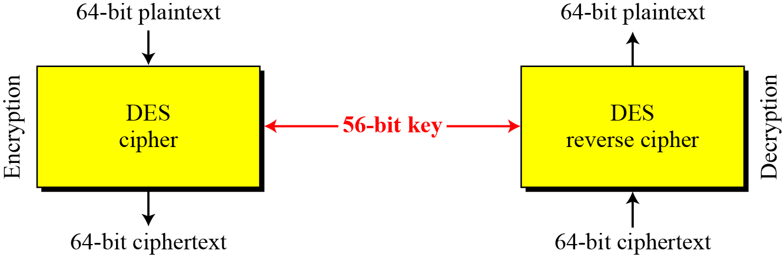
Overview
DES is a block cipher, as shown in Figure
Figure Encryption and decryption with DES

Slide 5
DES STRUCTURE
The encryption process is made of two permutations (P-boxes), which we call initial and final permutations, and sixteen Feistel rounds.
Initial and Final Permutations
Rounds
Cipher and Reverse Cipher
Examples

Slide 6
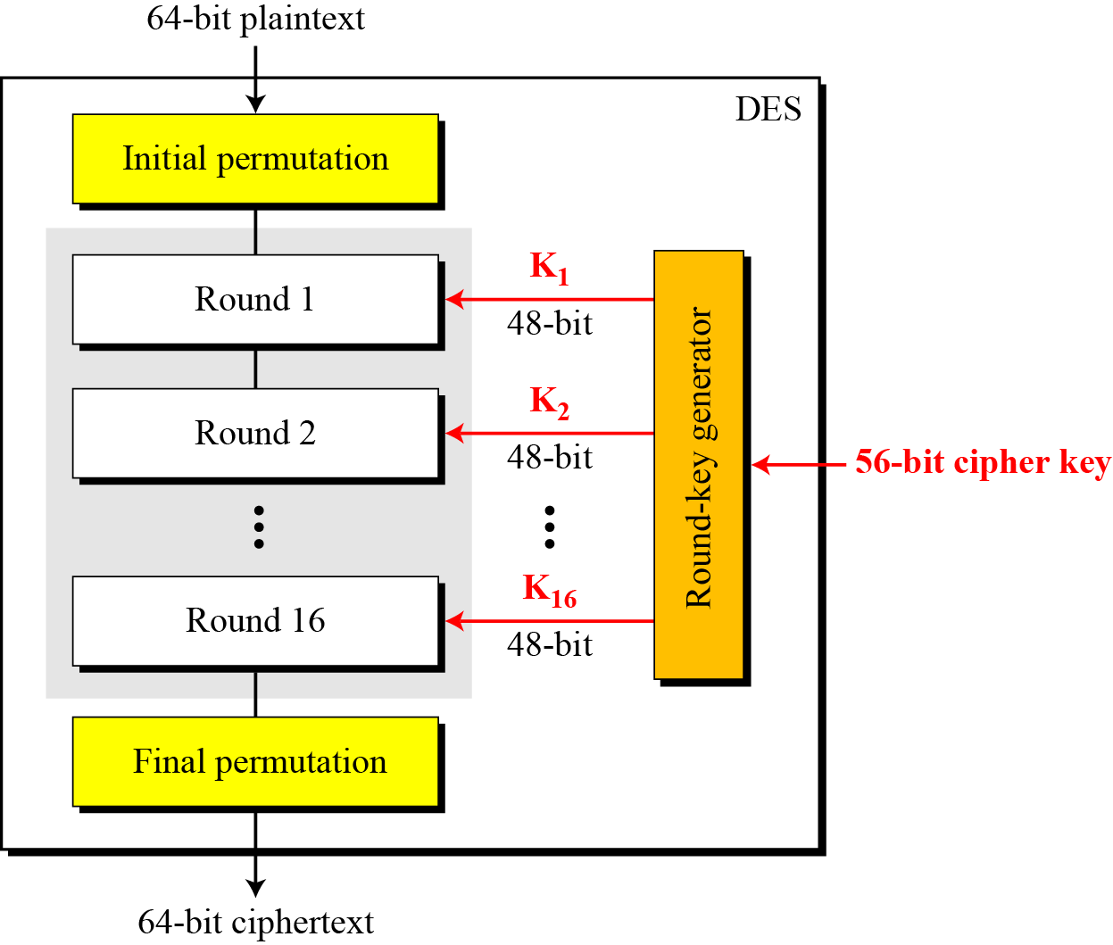
Figure General structure of DES

Slide 7
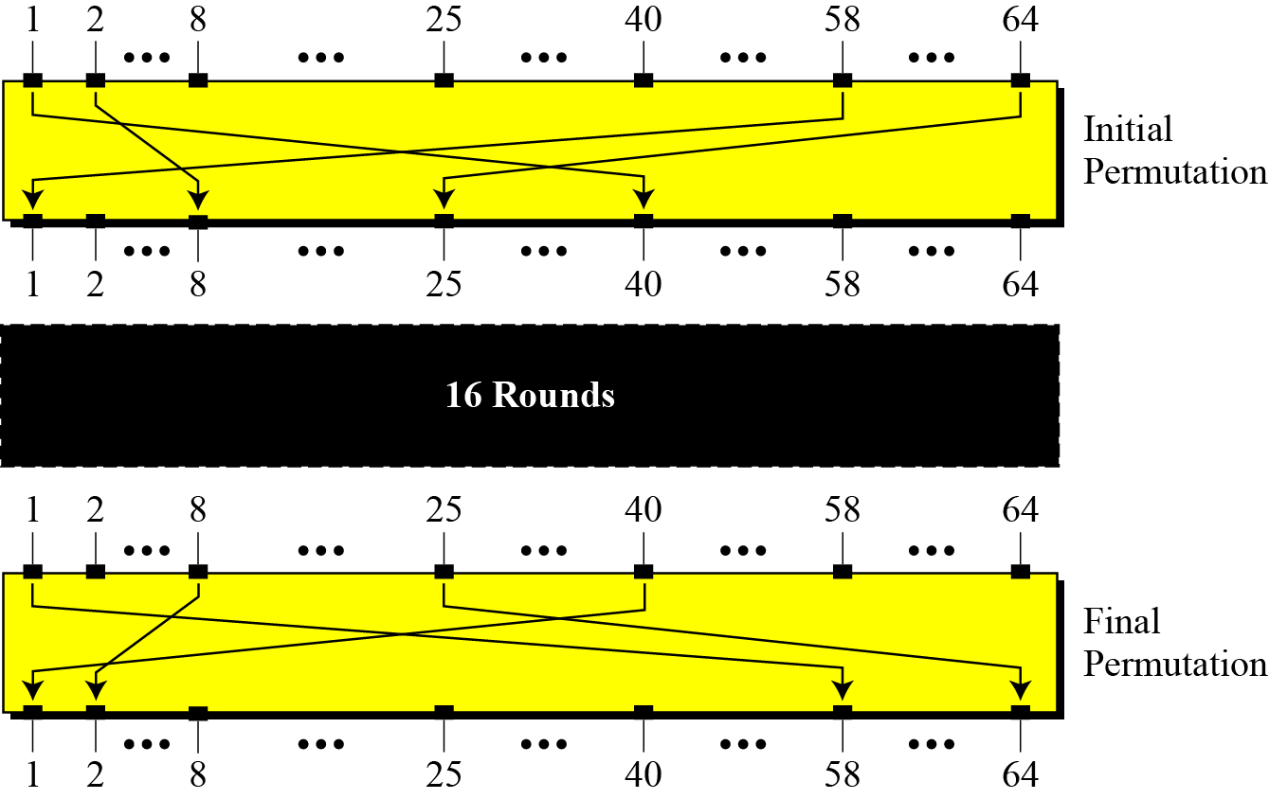
Initial and Final Permutations
Initial and final permutation steps in DES

Slide 8
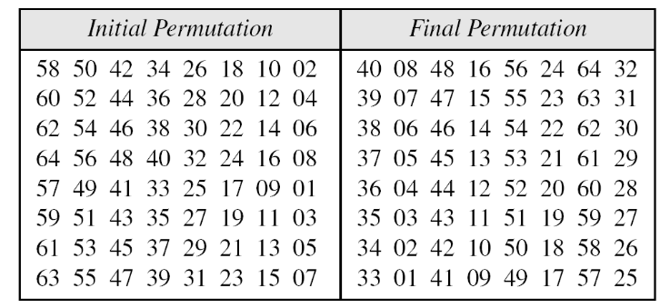
Continue
Initial and final permutation tables

Slide 9

Continued
Note
The initial and final permutations are straight P-boxes that are inverses of each other.
They have no cryptography significance in DES.

Slide 10
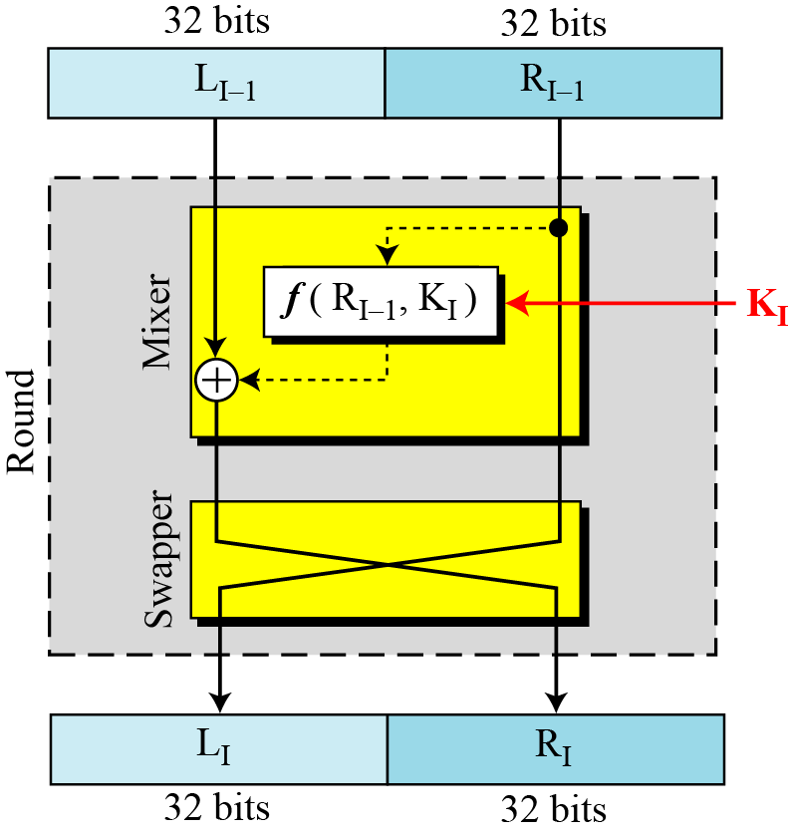
Rounds
DES uses 16 rounds. Each round of DES is a Feistel cipher.
Figure A round in DES (encryption site)

Slide 11
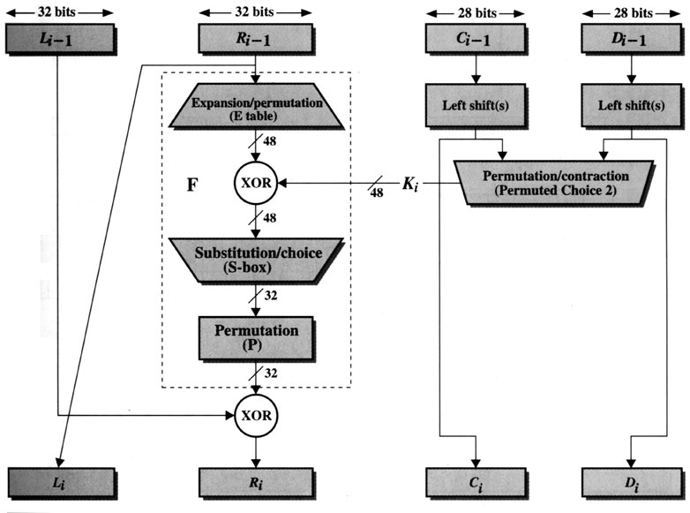
Encryption
(Key Generation)
[1]

Slide 12
Encryption (Round) (cont.)
L_{i-1}
R_{i-1}
Expansion/permutation (E_table)
XOR
K_{i}
F
Substitution/choice (S-box)
Permutation (P)
XOR
L_{i}
R_{i}

Slide 13
Example
Plain Text : 02468aceeca86420 Key: 0f1571c947d9e859
Represent each bit of the plaintext in BCD
0000 0010 0100 0110 1000 1010 1100 1110 1110 1100 1010 1000 0110 0100 0010 0000
Representation in IP table 0 1 0 1 1 0 1 0
0 0 0 0 0 0 0 0
0 1 0 1 1 0 1 0
0 0 0 0 0 0 0 0
0 0 1 1 1 1 0 0
1 1 1 1 0 0 0 0
0 0 1 1 1 1 0 0
0 0 0 0 1 1 1 1
Li 0101 1010 0000 0000 0101 1010 0000 0000
Ri 0011 1100 1111 0000 0011 1100 0000 1111

Slide 14
Example
Key: 0f1571c947d9e859
0000 1111 0001 0101 0111 0001 1100 1001 0100 0111 1101 1001 1110 1000 0101 1001
0 0 0 0 1 1 1 1
0 0 0 1 0 1 0 1
0 1 1 1 0 0 0 1
1 1 0 0 1 0 0 1
0 1 0 0 0 1 1 1
1 1 0 1 1 0 0 1
1 1 1 0 1 0 0 0
0 1 0 1 1 0 0 1

Slide 15
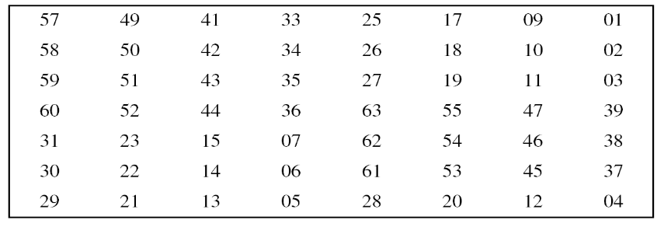
Fill in PC-1 table 0 1 1 0 1 0 0
0 1 1 1 1 1 1
0 0 0 1 0 0 0
1 0 0 1 0 1 0
0 0 0 1 0 0 0
1 0 0 0 1 0 0
1 1 1 1 1 0 1
0 0 1 0 1 1 0
011010001111110001001010000100010011111010010110
After left shift
110100011111100010010100001000100111110100101100

Slide 16
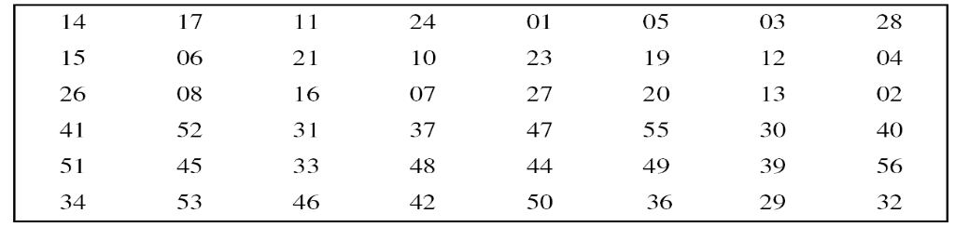
Table Key-compression table(PC-2)
Fill in PC-2 table 0 1 1 1 1 0 0 0
0 0 1 1 0 0 1 1
1 1 0 0 0 0 1 1
0 0 1 0 0 0 0 0
1 1 0 1 1 0 1 0
0 1 1 1 0 0 0 0

Slide 17
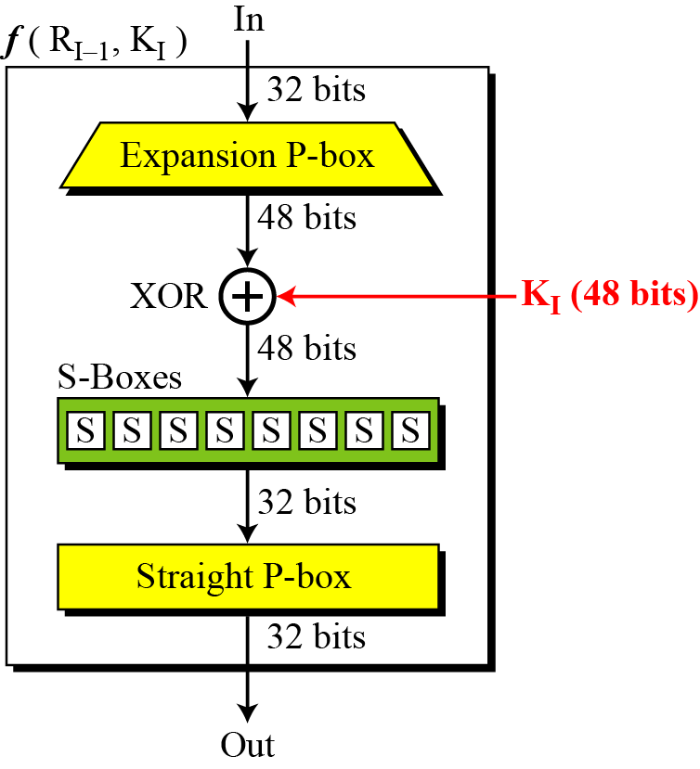
Continued
DES Function
The heart of DES is the DES function. The DES function applies a 48-bit key to the rightmost 32 bits to produce a 32-bit output.
Figure DES function

Slide 18
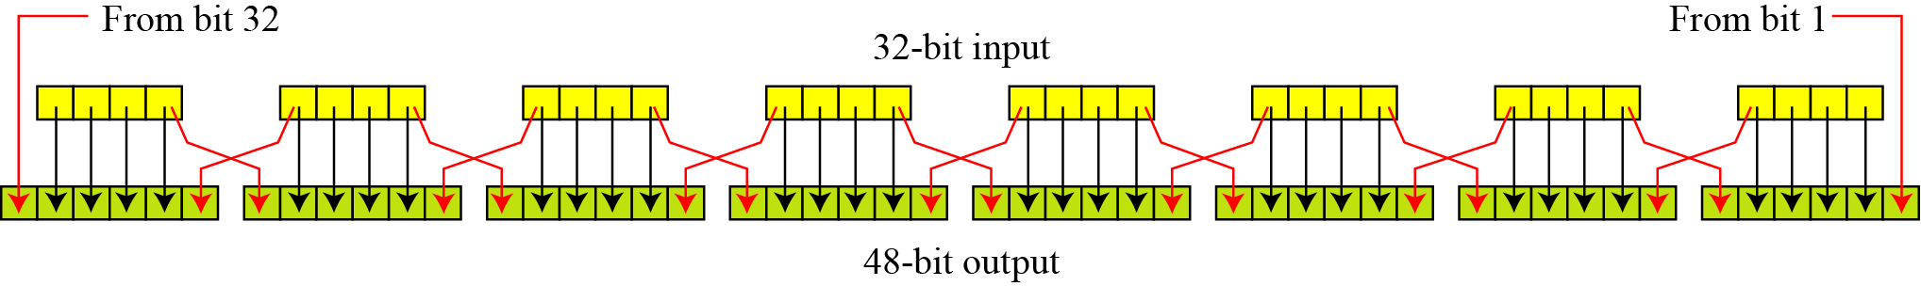
Continue
Expansion P-box
Since R_{I−1} is a 32-bit input and K_{I} is a 48-bit key, we first need to expand R_{I−1} to 48 bits.
Expansion permutation

Slide 19
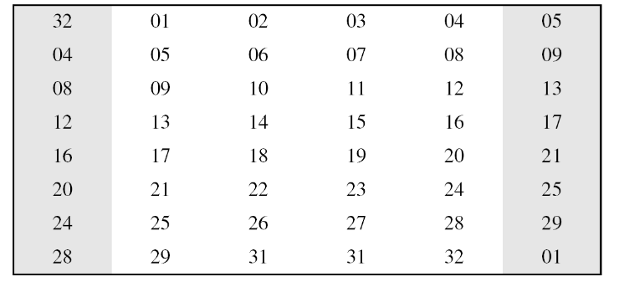
Continue
Although the relationship between the input and output can be defined mathematically, DES uses Table to define this P-box.
Table Expansion P-box table

Slide 20
Continue
Whitener (XOR)
After the expansion permutation, DES uses the XOR operation on the expanded right section and the round key. Note that both the right section and the key are 48-bits in length. Also note that the round key is used only in this operation.

Slide 21
Ri 0011 1100 1111 0000 0011 1100 0000 1111
Expansion
1 0 0 1 1 1
1 1 1 0 0 1
0 1 1 1 1 0
1 0 0 0 0 0
0 0 0 1 1 1
1 1 1 0 0 0
0 0 0 0 0 1
0 1 1 1 1 0
XOR
100111 111001 011110 100000 000111 111000 000001 011110
011110 000011 001111 000011 001000 001101 101001 110000
111001 111010 010001 100011 001111 110101 101000 101110

Slide 22
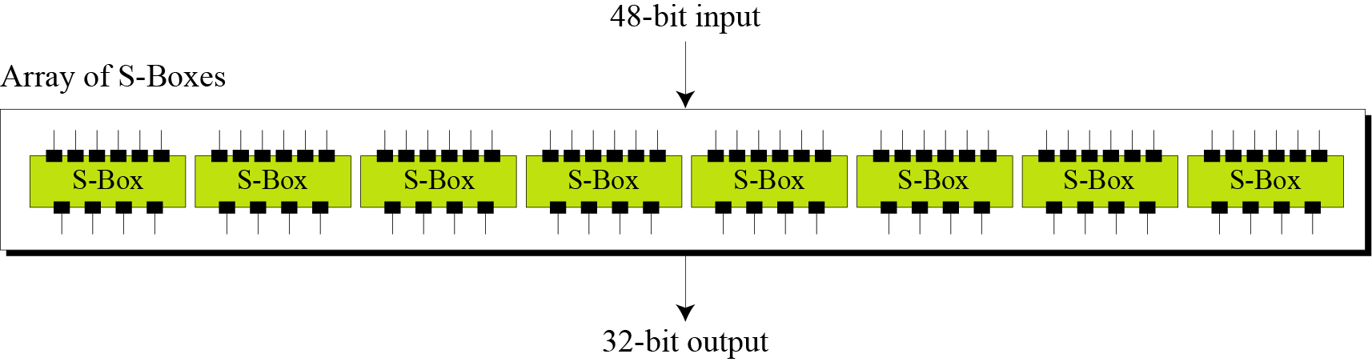
S-Boxes
The S-boxes do the real mixing (confusion). DES uses 8 S-boxes, each with a 6-bit input and a 4-bit output. See Figure
Figure S-boxes

Slide 23
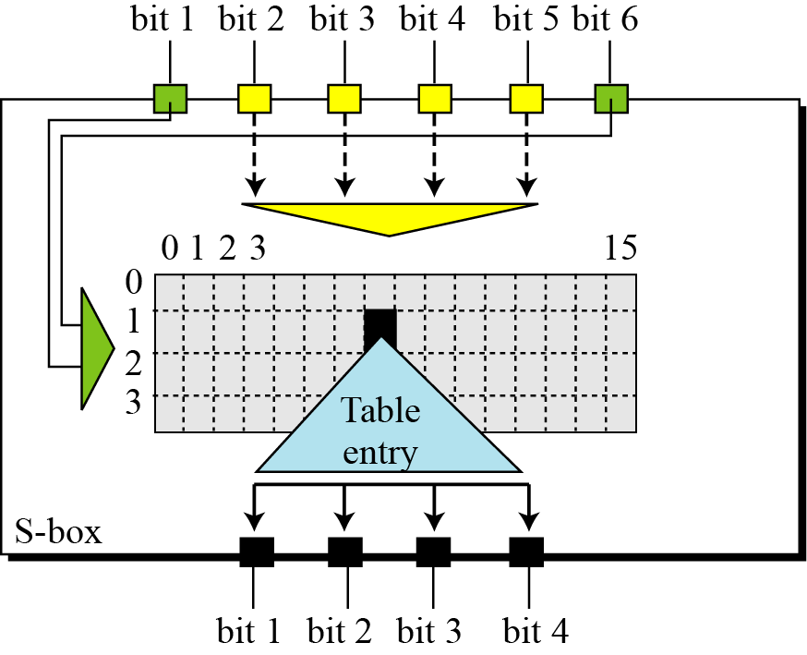
Figure S-box rule

Slide 24
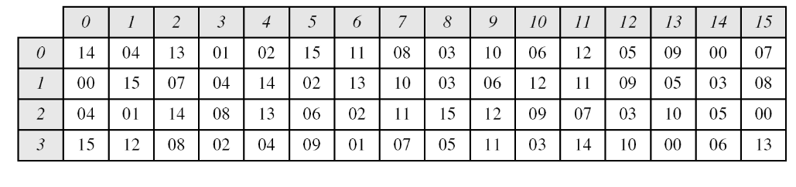
Table shows the permutation for S-box 1. For the rest of the boxes see the textbook.
Table S-box 1

Slide 25
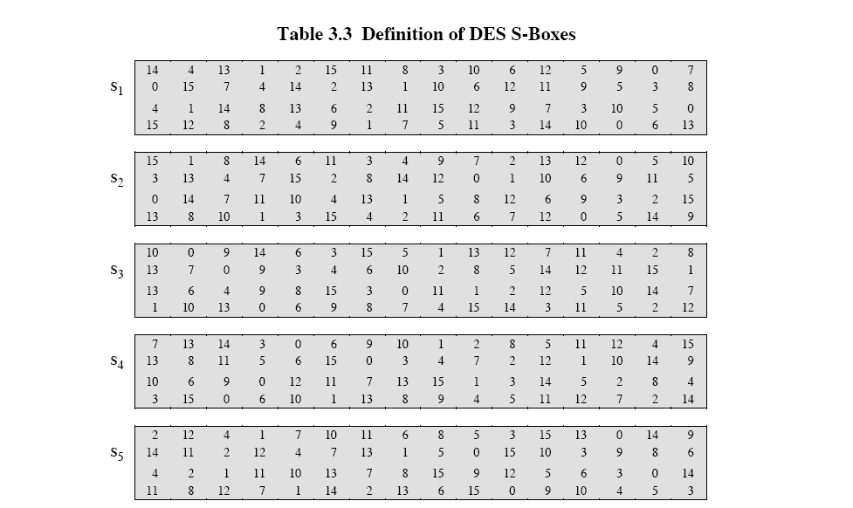
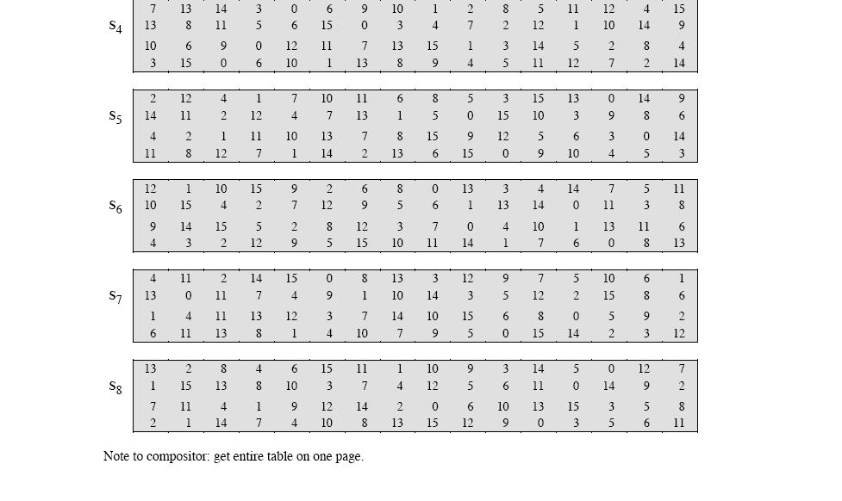
Encryption (Round) (cont.)
S-box

Slide 26
Example
The input to S-box 1 is 100011. What is the output?
Solution
If we write the first and the sixth bits together, we get 11 in binary, which is 3 in decimal. The remaining bits are 0001 in binary, which is 1 in decimal. We look for the value in row 3, column 1, in Table (S-box 1). The result is 12 in decimal, which in binary is 1100. So the input 100011 yields the output 1100.

Slide 27
Example
The input to S-box 8 is 000000. What is the output?
Solution
If we write the first and the sixth bits together, we get 00 in binary, which is 0 in decimal. The remaining bits are 0000 in binary, which is 0 in decimal. We look for the value in row 0, column 0, in Table 6.10 (S-box 8). The result is 13 in decimal, which is 1101 in binary. So the input 000000 yields the output 1101.

Slide 28
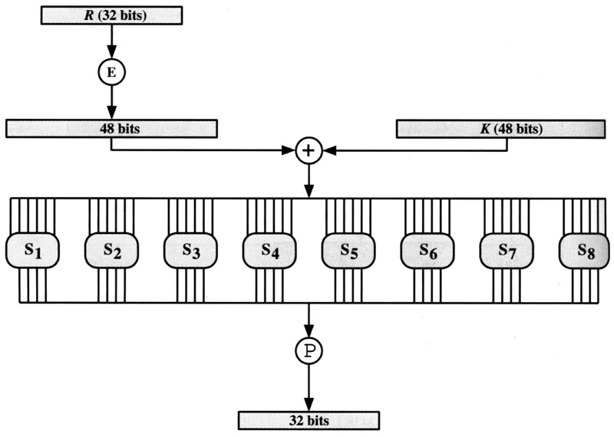
Encryption (Round) (cont.)
F
S-box

Slide 29
1 1 1 0 0 1
1 1 1 0 1 0
0 1 0 0 0 1
1 0 0 0 1 1
0 0 1 1 1 1
1 1 0 1 0 1
1 0 1 0 0 0
1 0 1 1 1 0
S1 S2 S3 S4 S5 S6 S7 S8
10 3 2 15 1 1 12 2
1010 0011 0010 1111 0001 0001 1100 0010

Slide 30
P
16 | 7 | 20 | 21 | 29 | 12 | 28 | 17
1 | 15 | 23 | 26 | 5 | 18 | 31 | 10
2 | 8 | 24 | 14 | 32 | 27 | 3 | 9
9 | 13 | 30 | 6 | 22 | 11 | 4 | 25
1 1 0 0 0 0 0
1 1 0 1 0 0 1 0
0 1 1 1 0 0 1 0
0 1 0 0 0 1 0 1
Li= 3cf03cof
1110 0000 1101 0010 0111 0010 0100 0101
0101 1010 0000 0000 0101 1010 0000 0000
1011 1010 1101 0010 0010 1000 0100 0101
b a d 2 2 8 4 5

Slide 31
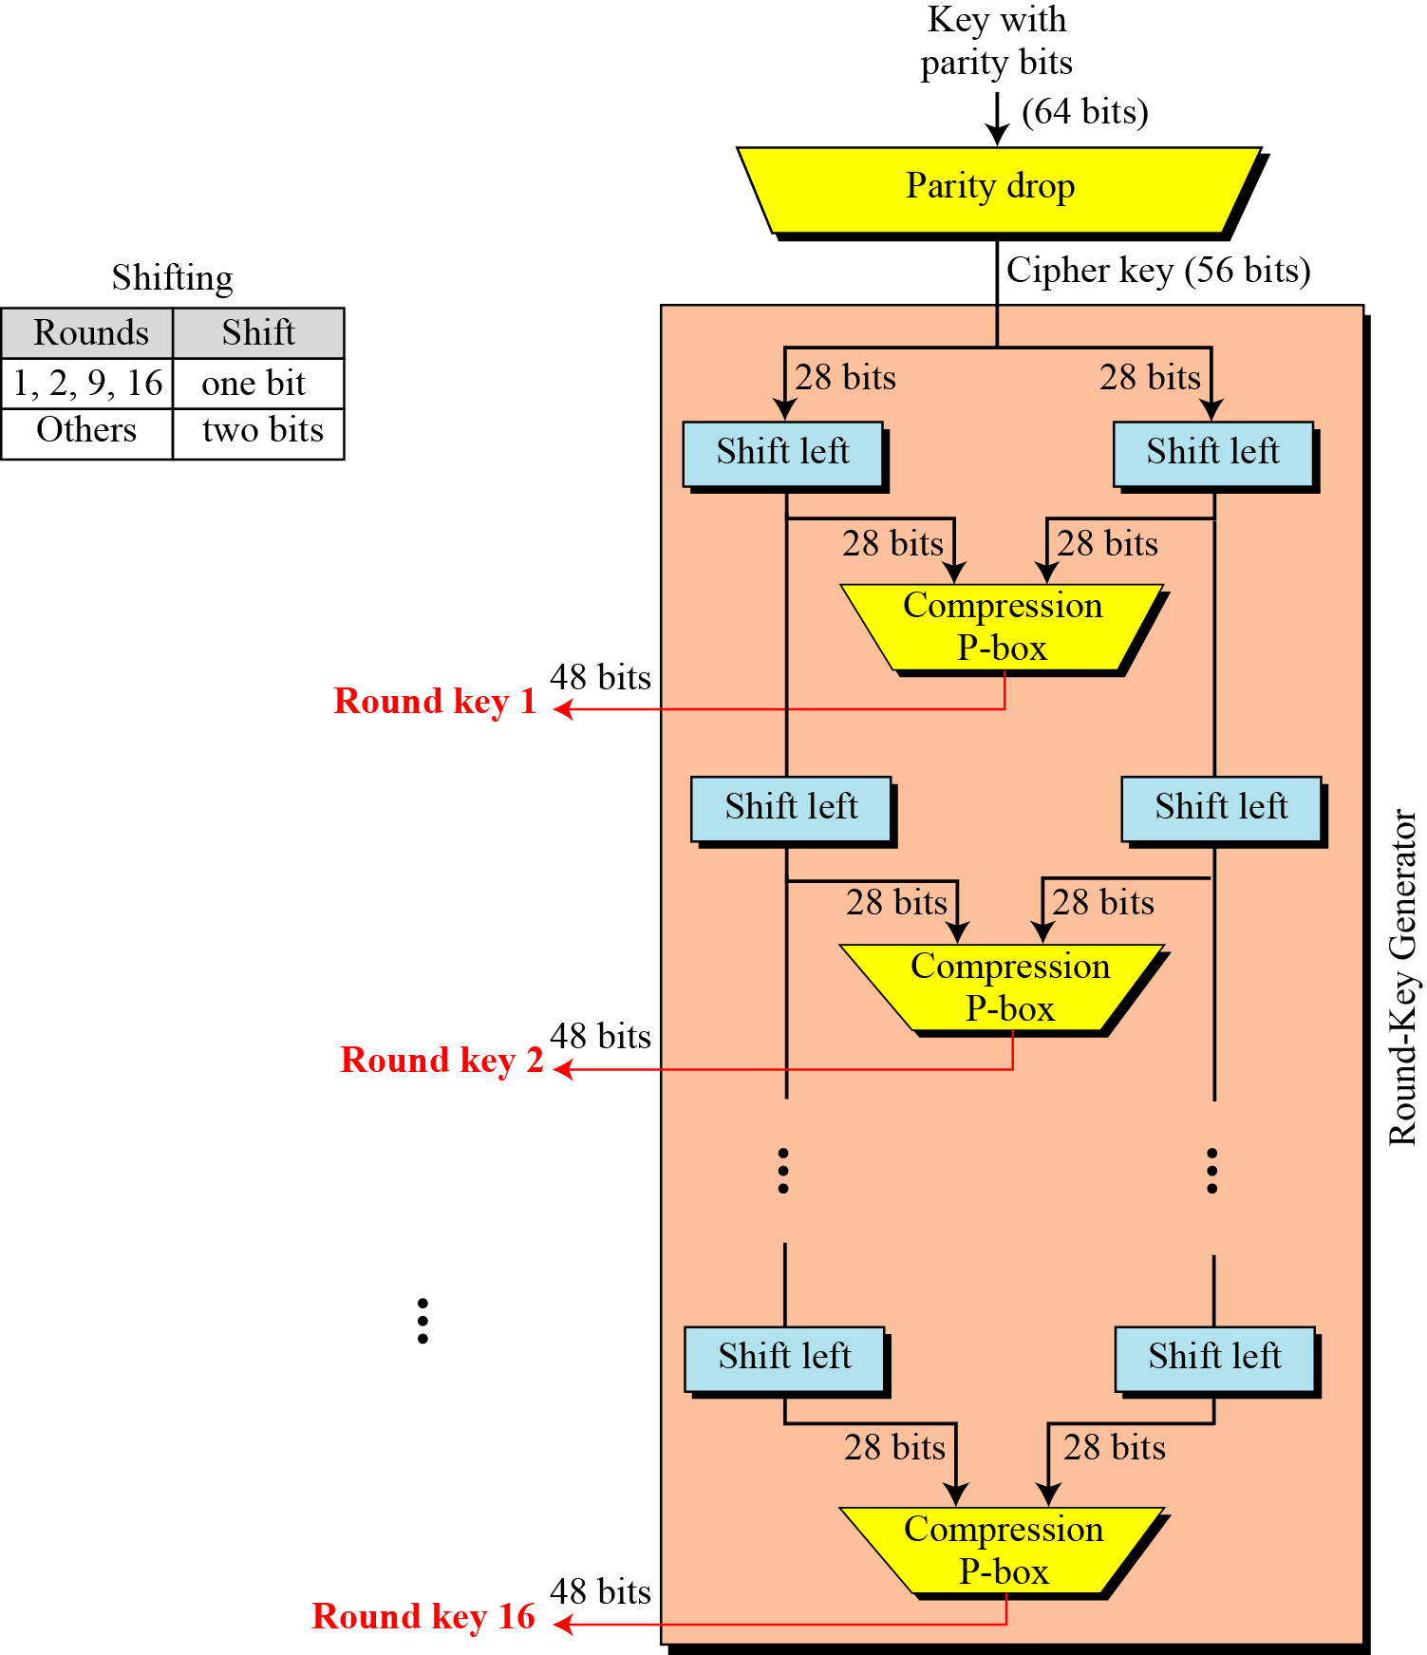
Continued
Figure Key generation

Slide 32
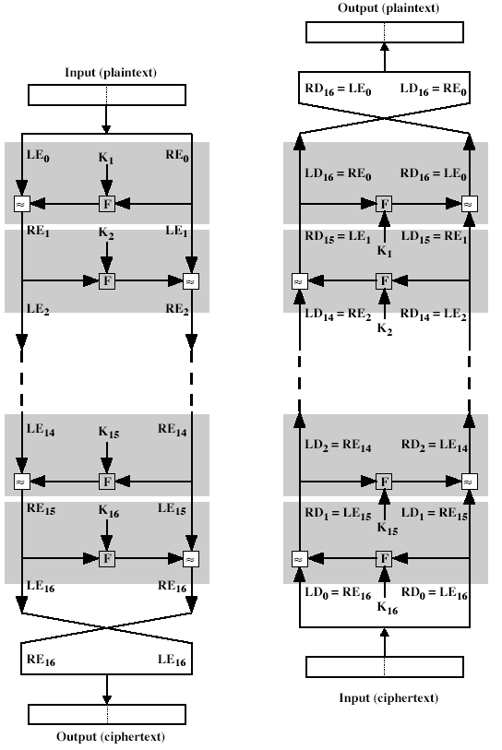
Decryption
The same algorithm as encryption.
Reversed the order of key (Key₁₆, Key₁₅, … Key₁).
For example:
IP undoes IP⁻¹ step of encryption.
1st round with SK16 undoes 16th encrypt round.

Slide 33
Strength of DES
Criticism
Reduction in key size of 72 bits
Too short to withstand with brute-force attack
S-boxes were classified.
Weak points enable NSA to decipher without key.
56-bit keys have 2⁵⁶ = 7.2 x 10¹⁶ values
Brute force search looks hard.
A machine performing one DES encryption per microsecond would take more than a thousand year to break the cipher.

Slide 34
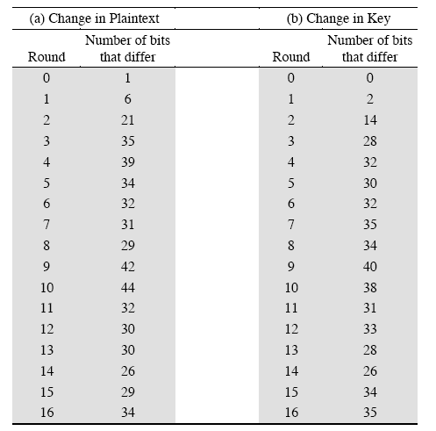
Strength of DES (cont.)
Avalanche effect in DES
If a small change in either the plaintext or the key, the ciphertext should change markedly.
DES exhibits a strong avalanche effect.

Slide 35
Ultimate
DES was proved insecure
In 1997 on Internet in a few months
in 1998 on dedicated h/w (EFF) (Electronic Frontier Foundation)in a few days
In 1999 above combined in 22hrs!

Slide 36
Double-DES?
could use 2 DES encrypts on each block
C = E_{K2}(E_{K1}(P))
issue of reduction to single stage
and have “meet-in-the-middle” attack
works whenever use a cipher twice
since X = E_{K1}(P) = D_{K2}(C)
attack by encrypting P with all keys and store
then decrypt C with keys and match X value
can show takes O(2⁵⁶) steps
Notes:
‹#›
The simplest form of multiple encryption has two encryption stages and two keys - Double-DES.
Have concern that there might be a single key that is equivalent to using 2 keys as above, not likely but only finally proved as impossible in 1992.
More seriously have the “meet-in-the-middle” attack, first described by Diffie in 1977. It is a known plaintext attack (ie have know pair (P,C), and attempts to find by trial-and-error a value X in the “middle” of the double-DES encryption of this pair, and chances of this are much better at O(2^56) than exhaustive search at O(2^112).

Slide 37
Triple-DES with Two-Keys
hence must use 3 encryptions
would seem to need 3 distinct keys
but can use 2 keys with E-D-E sequence
C = E_{K1}(D_{K2}(E_{K1}(P)))
nb encrypt & decrypt equivalent in security
if K1=K2 then can work with single DES
standardized in ANSI X9.17 & ISO8732
no current known practical attacks
several proposed impractical attacks might become basis of future attacks
Notes:
‹#›
Triple-DES with two keys is a popular alternative to single-DES, but suffers from being 3 times slower to run. The use of encryption & decryption stages are equivalent, but the chosen structure allows for compatibility with single-DES implementations. 3DES with two keys is a relatively popular alternative to DES and has been adopted for use in the key management standards ANS X9.17 and ISO 8732. Currently, there are no practical cryptanalytic attacks on 3DES. Coppersmith notes that the cost of a brute-force key search on 3DES is on the order of 2^112 (=5*10^33) and estimates that the cost of differential cryptanalysis suffers an exponential growth, compared to single DES, exceeding 10^52.
There are several proposed attacks on 3DES that, although not currently practical, give a flavor for the types of attacks that have been considered and that could form the basis for more successful future attacks. See text for details.

Slide 38
Triple-DES with Three-Keys
although are no practical attacks on two-key Triple-DES have some indications
can use Triple-DES with Three-Keys to avoid even these
C = E_{K3}(D_{K2}(E_{K1}(P)))
has been adopted by some Internet applications, eg PGP, S/MIME
Notes:
‹#›
Although the attacks currently known appear impractical, anyone using two-key 3DES may feel some concern. Thus, many researchers now feel that three-key 3DES is the preferred alternative. Three-key 3DES has an effective key length of 168 bits and is defined as shown. A number of Internet-based applications have adopted three-key 3DES, including PGP and S/MIME.

